Slide 1
Carbon Pricing
This is the way
Paul J. Hibbard
New England Restructuring Roundtable
December 2020

Slide 2
Context: Economy-Wide Decarbonization
Various potential policy mechanisms in play
Outcome could be one or a combo
Some could apply universally (carbon pricing), others could be implemented on a sector-by-sector basis
Focus on electricity - wholesale market design options and impact of broader carbon pricing on electricity markets

Slide 3
Carbon Pricing: Let’s Get This Part Over With…
The obvious (conventional wisdom): carbon pricing at levels needed to meet mandates is not likely to become the primary basis for meeting New England state climate targets
Politically suspect; “tax”
The numbers would need to be high
Supportive policymakers, legislators, governors remain few and far between
Opposed by key groups and industries, including those that benefit from entrenched policies
The only things more obvious:
This is crazy
Because of this, consumers and businesses will pay substantially more to meet emission reduction requirements
Because of this, states will continue to administer a wide-ranging palette of complicated policy programs, with associated costs and inefficiencies

Slide 4
Not Your Grandmother’s Public Policy Challenge
Fossil fuels = energy = economy = jobs = human health and welfare
One link to break, yet fossil fuels are deeply embedded
Massive transformation, costs over short period of time; stranded costs; potentially regressive outcomes
Regulatory inefficiencies will be amplified in scope and scale
Much is at stake
Feasibility of achieving targets, with reasonable progress along the way
Costs of compliance across all sector - transportation costs, heating costs, electricity costs
Distribution of energy costs and health impacts across communities, economic strata
Reliability of natural gas/heating supply and power supply
Financial stability and shareholder value of regulated utilities
Utilization of existing, undepreciated infrastructure; stranded costs
Wholesale market viability for capacity addition/attrition
Risk absorbed by utility ratepayers through LT contracts, other infrastructure investments

Slide 5
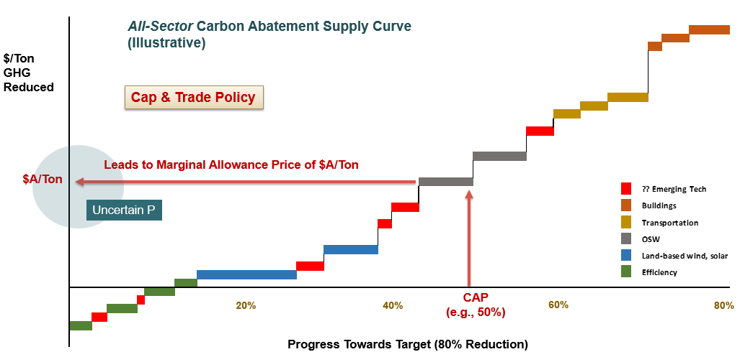
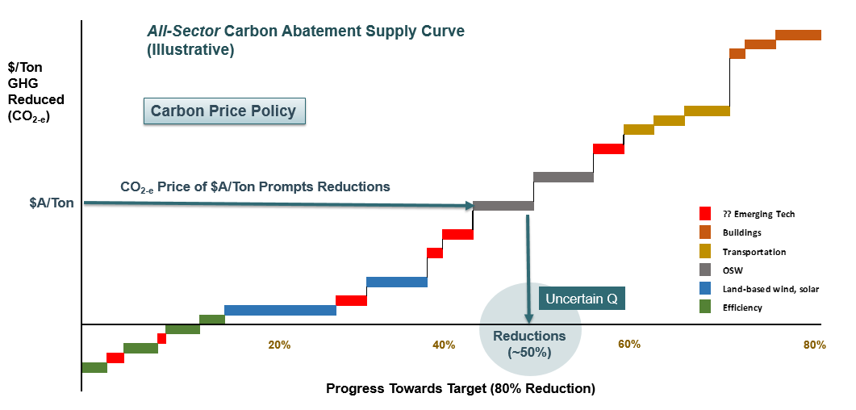
Carbon Pricing: What is it?
Tax or fee on GHG “emissions,” based on CO₂ equivalence (CO_{2-e})
or..
Cost of an allowance under an emission cap, with allowance trading
Assess based on emissions and/or carbon content of fuel (assuming complete combustion)
Periodically review program results, adjust price or cap, ala RGGI
Concerns over uncertain Q or uncertain P are overstated, unwarranted, easily remedied

Slide 6
Carbon Pricing: Simple Mechanics
Price of $X/CO_{2-e} (or requirement to turn over allowances per ton of emission potential)
Applied at point of entry (e.g. nat gas), distribution (e.g. gasoline), or emissions
Not required to price in wholesale market; opportunity cost will be included in market offers
Based on carbon content (or equivalent)
Jurisdictions decide what to do with C price or allowance auction revenues (e.g., consumer rebates or incentives)
Cost included in price of fuel and/or conversion products (e.g., electricity), flows through to carbon-intensive goods and services
Increases value and profits of GHG-reducing technologies, practices (EVs, heat pumps, renewable generation, EE); increases cost/decreases value of carbon-intensive technologies and goods/services based on them

Slide 7
Carbon Pricing: Simple Administration
Verify quantities and payments made (if price), or typical allowance auction and trading platforms (if cap); standard compliance enforcement provisions
Periodic review and adjustment of price or cap
Political decisions on revenue use
Conversely, none of the following would be needed (partial list):
Tax incentives for renewables, EVs, and their equity implications
Fuel or infrastructure bans
Net metering tariffs, with their regressive tendencies
“Green” or “renewable” retail electricity products, or their questionable validity
RPS/CES, with periodic changes and compliance administration
Long-term contract procurements, proceedings, litigation, or their imposition of investment risk on captive ratepayers
Arguments over transmission cost allocation for “policy” projects
Contorted band aids on wholesale capacity markets which are incompatible with state policy
EE investment requirements, council deliberations, EE plans, M&V, commission review

Slide 8
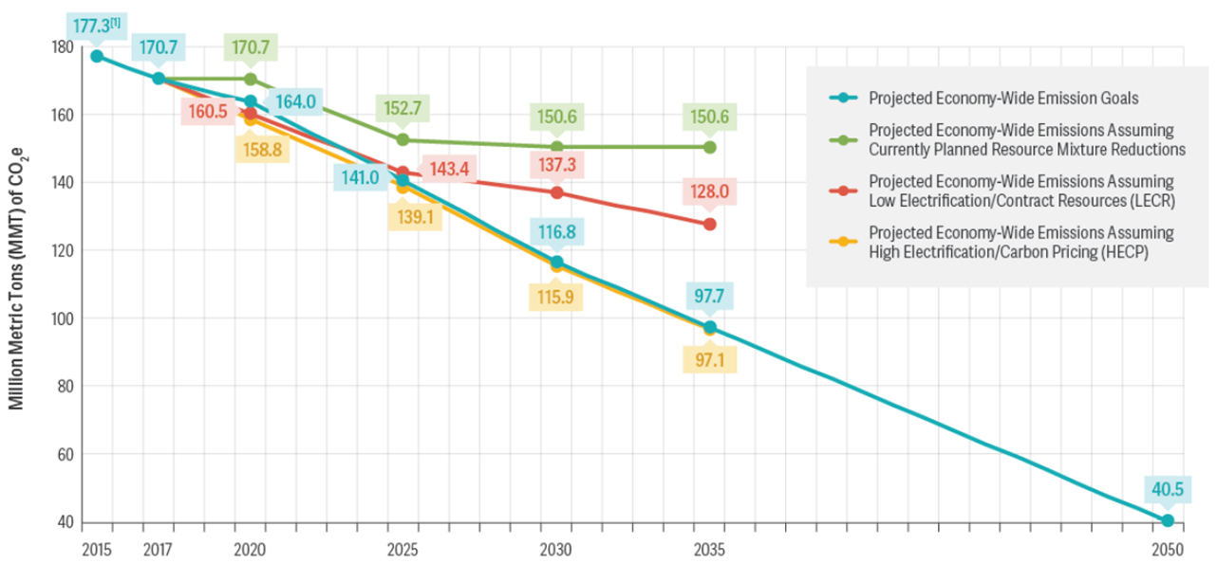
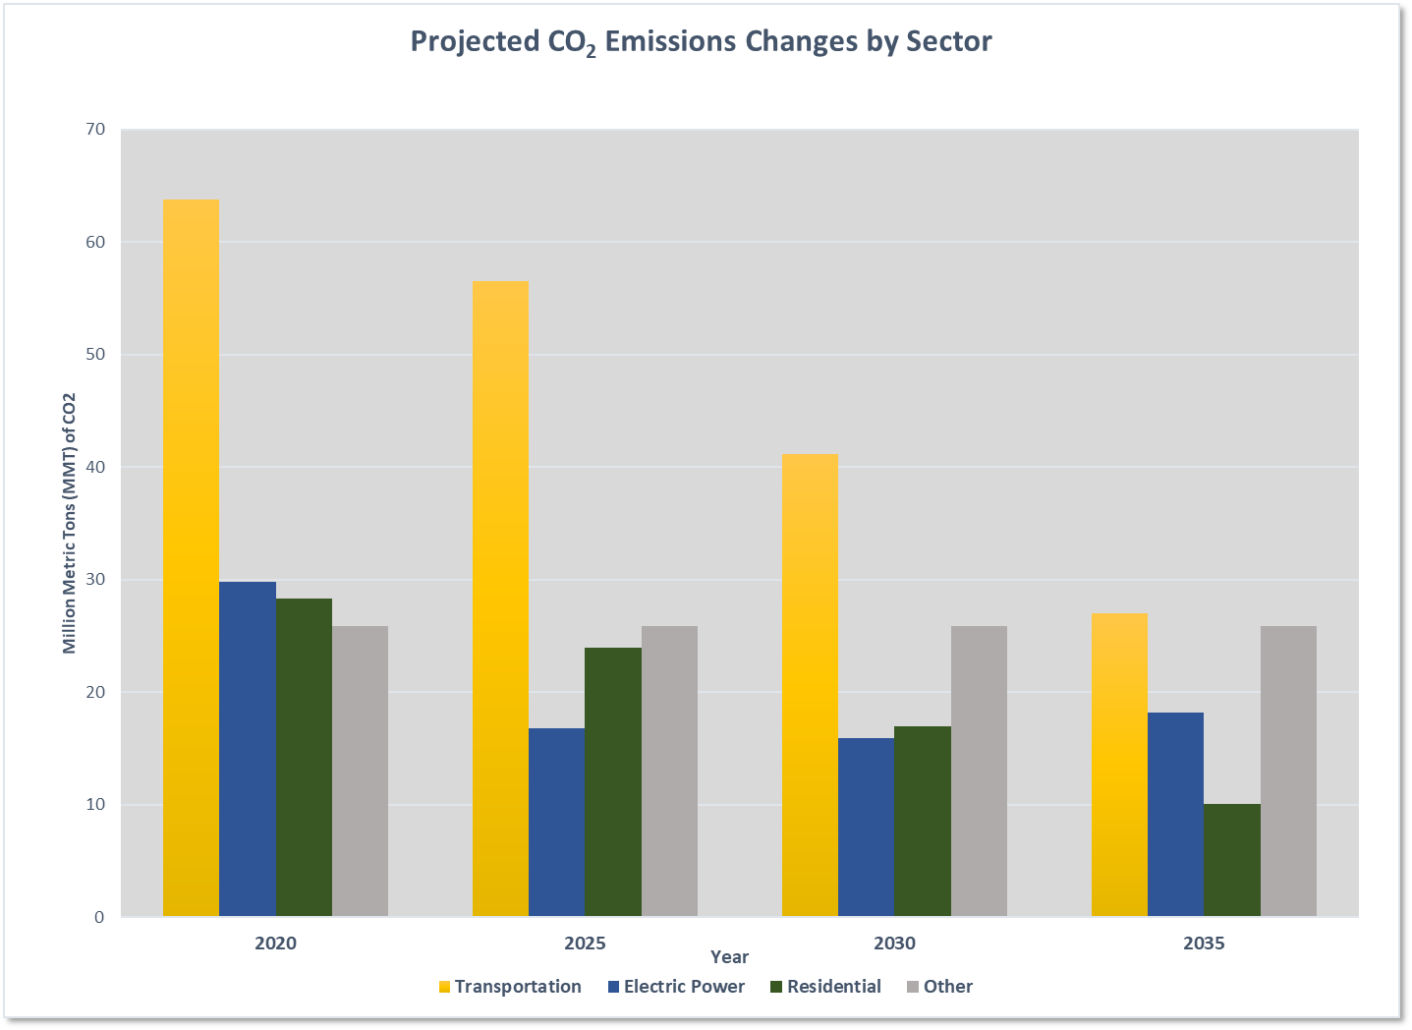
Analysis Group Study
New England state, economy-wide mandates/targets
In effect, a declining cap on GHG emissions across all economic sectors
Presume electrification of building, transportation
What price on carbon needed to make reasonable progress over next 15 years without public policy resources, MOPR issues?

Slide 9
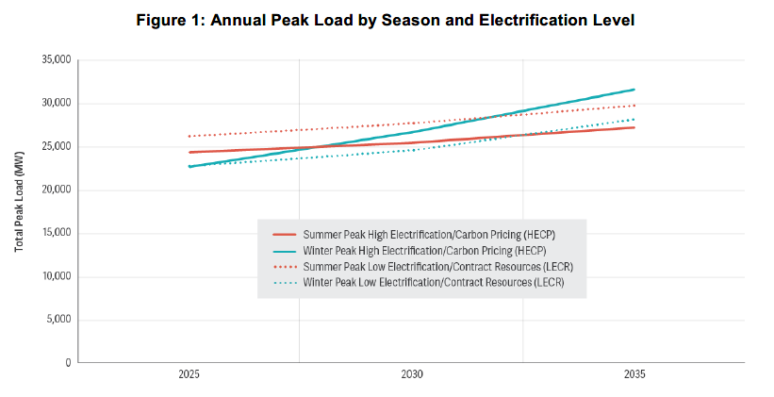
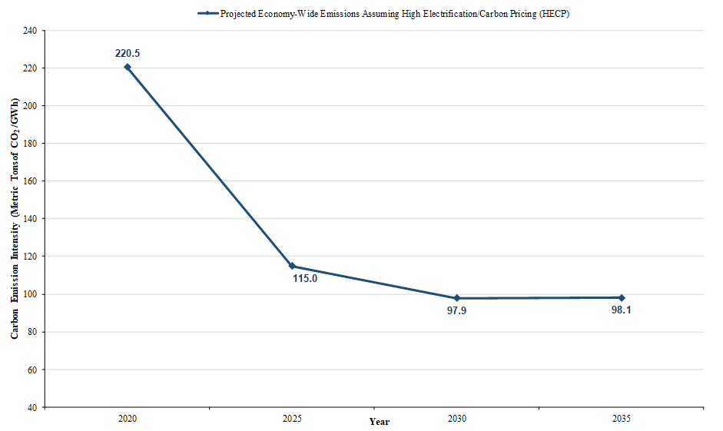
Electric Sector: the Carbon Sponge
10 GW winter peak demand growth over 10 years
Flat emissions with declining carbon intensity (lb/MWh), while absorbing substantial load growth that generates GHG reductions in transportation, building sectors
Yet carbon pricing is good for the electric sector
Integrates seamlessly with competitive wholesale markets, allows for harmony between policy and markets
Facilitates decarbonization of the grid at the lowest possible cost
Reduces investment risk placed on ratepayers
$25/ton increasing to $50 - $70/ton sufficient to eliminate OOM, MOPR issues

Slide 10
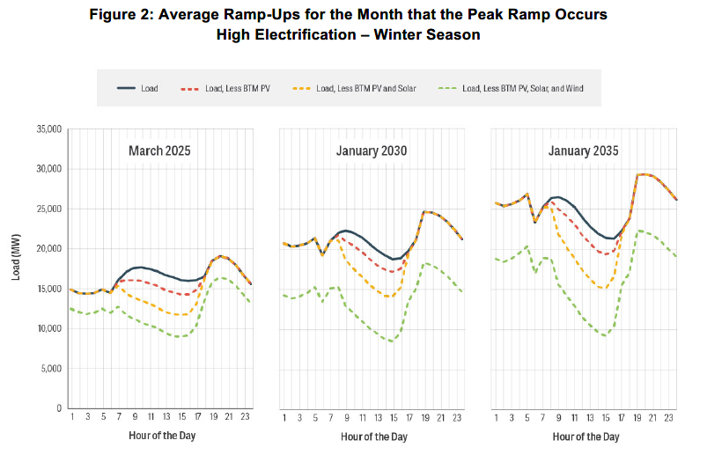
Flexible Resources Remain Important
Impact on system ramping requirements significant
Flexible resources needed
For at least 15 years, continued use of gas CC to manage net load variability would not delay linear progress to GHG targets (with electrification), while supporting reliable transition

Slide 11
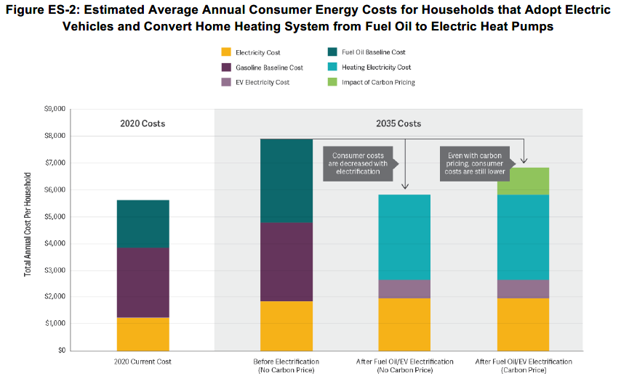
Energy Costs Reflect Inter-Sectoral Tradeoffs
Considering energy costs only (gasoline, heating fuel, electricity), price impacts appear manageable
C price revenues could be used to mitigate incremental investments over a managed transition (EVs, heat pumps)

Slide 12
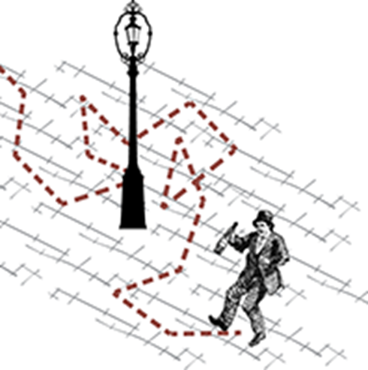
The Pathway Matters
The destination is known (…more or less)
2040 – 2050
GHG emissions ~ 80% - 100% less than now
Across all sectors of the economy
A random walk to compliance is not an option
States are being proactive, evaluating long-term pathways
Risk: increasingly difficult to forecast beyond 5-10 years
Emerging technologies in all sectors (H, RNG, storage, OSW, EVs, heat pumps…)
Accelerating changes in cost factors, operational capabilities; breakthroughs possible
Unpredictable economic and behavioral factors will strongly influence the nature and pace of change
Resource-specific policies and investments today will soon look outdated
All will be affected by the transition – consumers, businesses, shareholders
All-sector carbon pricing can simplify and rationalize the path forward
This is the way

Slide 13
Paul J. Hibbard
Principal
Analysis Group, Inc.
phibbard@analysisgroup.com
617.425.8171

